Slide 2
T32 Administration Updates: Pre-Award Changes and Post-award Q&A
Jenny Dahlberg, MS (she/her/hers)
Research Administration Director, School of Veterinary Medicine
Sarah Pavao (she/her/hers)
Director, Office of Training Grant Support

Slide 3
Learning Objectives
Review T32 program updates planned with Forms-I from NIH
  https://grants.nih.gov/grants/guide/notice-files/NOT-OD-24-129.html
  Preview: https://nexus.od.nih.gov/all/2024/09/24/preview-of-forms-i-application-form-and-training-data-table-changes-coming-in-2025/
Interactive session for T32 post-award management

Slide 4
Updates to Institutional Training Grant Applications
Updated: May 29, 2024

Slide 5
Changes Coming:
Updates to Institutional Training Grant Applications
Aims:
  Reduce applicant and reviewer burden.
  Further support the development of a biomedical research workforce that will benefit from the full range of perspectives, experiences and backgrounds needed to advance discovery.
Scope:
  Applies to applications submitted for due dates after January 25, 2025, using the following activity codes:
    Institutional Training– T series, e.g., T15, T32, T34, T35, T37, T90/R90, TL1, TL4
    International Institutional Training – D43, D71, U2R
    Institutional Career Development – KL2, K12
Guide Notice
NOT-OD-24-129

Slide 6
Why are Changes Being Made?
Over the past decade, NIH has made significant investments to develop, implement, assess and disseminate innovative, effective approaches to research training and mentoring and to prepare trainees for a variety of career paths in the biomedical research workforce.
The updates are driven by:
A need for evidence-informed mentoring practices that promote the development of trainees from all backgrounds.
The need to support trainees pursuing the full breadth of scientific career paths to advance the NIH mission.
The desire to reduce training grant applicant and reviewer burden.

Slide 7
Overview of the Updates
Key application changes:
  PHS 398 Research Training Program Plan Form - Recruitment Plan to Enhance Diversity will be its own attachment.
  Parent T32 Notice of Funding Opportunity (NOFO) – Define mentor training expectations.
  Update NRSA Data Tables to reduce burden and promote consistent information collection across training programs.
Key changes to peer review:
  Move “Responsible Conduct of Research” and “Recruitment Plan to Enhance Diversity” to Additional Review Considerations so they contribute to the overall impact score.
Notes:
To put in context, these are targeted updates, and not the wholesale restructuring that is happening, for example, with fellowships.
Through these changes NIH aims to
Reduce applicant and reviewer burden.
Further support the development of a biomedical research workforce that will benefit from the full range of perspectives, experiences and backgrounds needed to advance discovery.

Slide 8
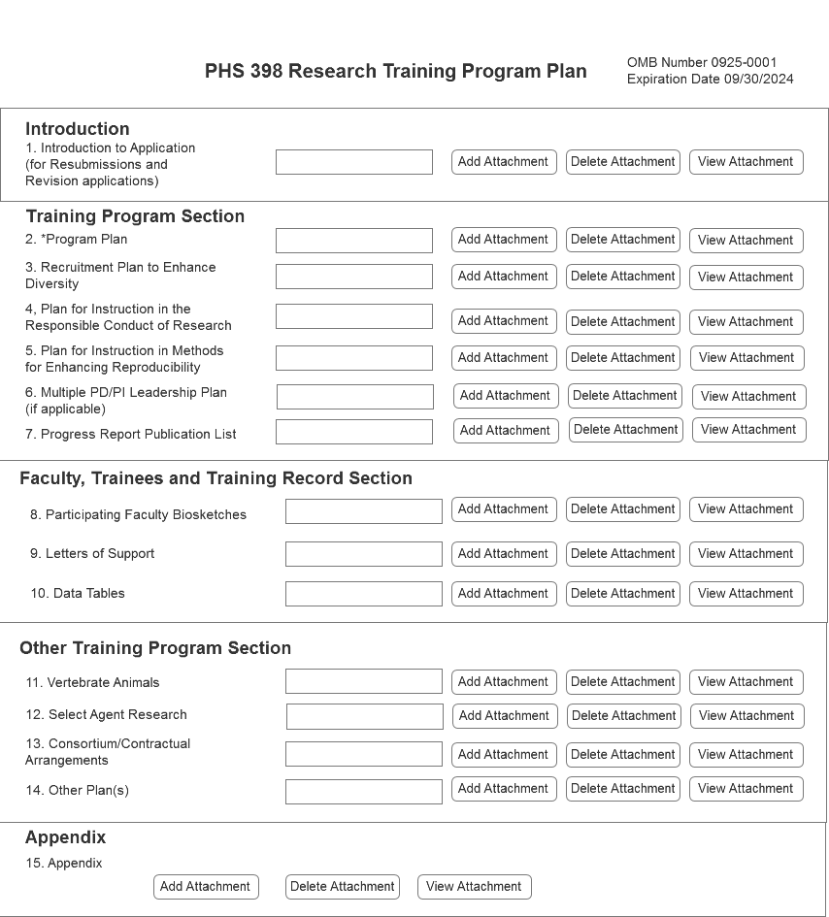
Application Updates
PHS 398 Research Training Program – Updated Form
Updated form
The Recruitment Plan to Enhance Diversity will be made its own attachment on the PHS 398 Research Training Program Form
Program Plan (25-Page Limit)
  Background
  Program Plan
Recruitment Plan to Enhance Diversity (3-page limit)
Plan for Instruction in the Responsible Conduct of Research
Plan for Instruction in Methods for Enhancing Reproducibility
Multiple PD/PI Leadership Plan (if applicable)
Progress Report (for Renewal applications)

Slide 9
Funding Opportunity Updates
Mentor Training Expectations and Career Outcomes
Parent T32s will include language to better define and support expectations for mentor training
Addressed in the program considerations, program plan, and review criteria
Potential mentor training topics include:
  Aligning expectations
  Maintaining effective communication
  Fostering independence
  Assessing scholars' understanding of scientific research
  Enhancing professional development
  Addressing equity and inclusion
  Articulating mentoring philosophy and plan
Programs should adapt mentor training topics to suit program and trainee needs.

Slide 10
Peer Review Updates
Training grants will retain the five scored review criteria currently used in review.
  Training Program and Environment
  Training Program Director(s)/Principal Investigator(s)
  Preceptors/Mentors
  Trainees
  Training Record
“Training and the Responsible Conduct of Research” and “Recruitment Plan to Enhance Diversity” will be moved to Additional Review Criteria
  Will now contribute to the overall impact score when these were previously post-score considerations

Slide 11
Data Table Updates
General and Program-Specific Updates
Changes are intended to reduce burden and promote consistency in the requested information
For all data tables
  Updated table instructions to clarify terms and provide consistency in lettering for training stage
  Remove redundancies by not asking for structured data available elsewhere in the application
Multiple changes specific to predoctoral, postdoctoral, undergraduate, and international training tables, including:
  Update Table 1 - applicants will only be required to provide information relevant to the training stage(s) in the proposed program.
  Realign table 5 - focus on the outcomes only on trainees supported by the grant.
  Table 6 - remove some trainee characteristics.
  Table 8 - remove “Part II. Those Clearly Associated with the Training Grant” & encourage reporting this information in the Program Plan Section or RPPR narrative.

Slide 12
Data Table Updates
Changes Impacting all Applications
Overall, updates to reduce burden and promote consistency in requested information.
Table 1 (Census of Participating Department or Interdepartmental Programs)
  Currently, T32 applicants provide information on predoctorates and postdoctorates, regardless of the training stage of the proposed program.
  Planned update:
    Applicants will be required to provide data only relevant to the training stage(s) in the proposed program.
    Undergraduate training programs (T34) will include this table.
Table 8: Program Outcomes
  Currently, asks T32 grantees to include “Clearly associated” trainees.
  Planned Update: Remove “Part II. Those Clearly Associated with the Training Grant” – encourage to report in Program Plan Section or RPPR narrative.
Notes:
We are not asking them to do more (except T34, where we’re looking for consistency with other Ts)
Information removed can be provided in the narrative if applicants/grantees want to

Slide 13
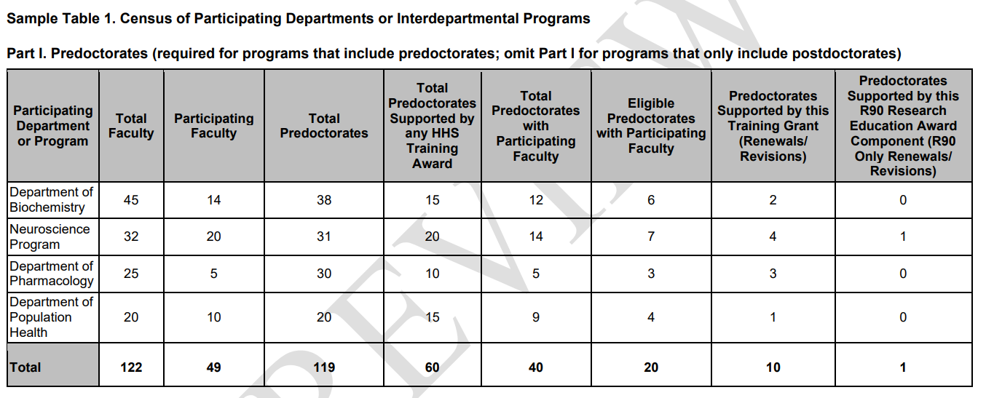
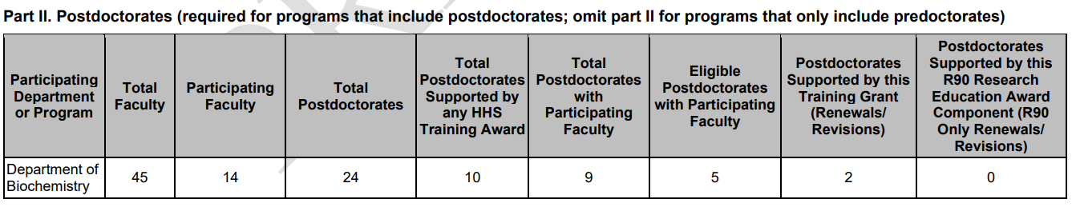
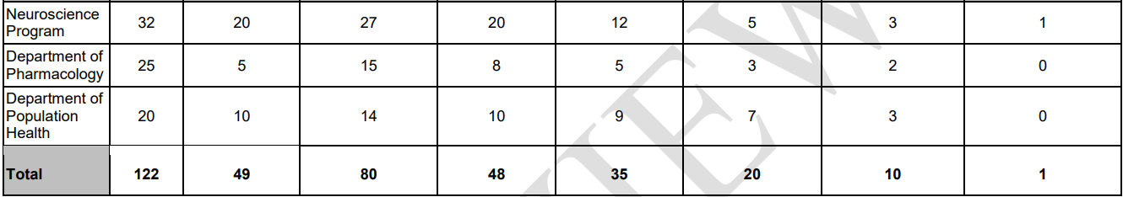

Slide 14
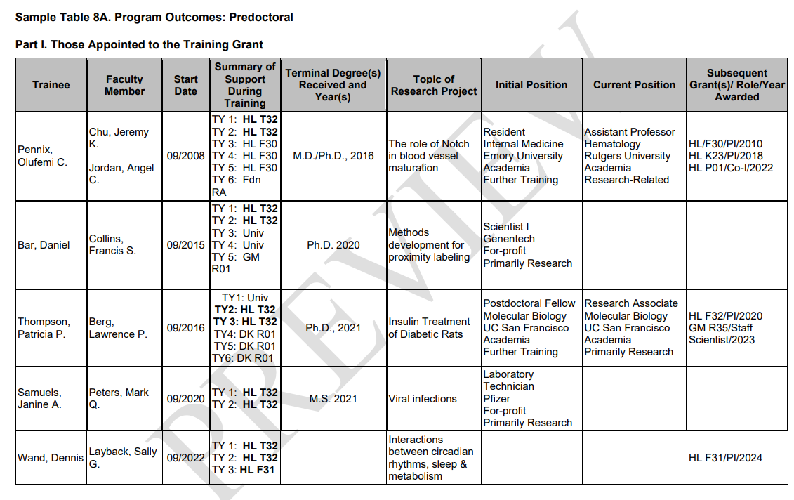

Slide 15
Data Table Updates
Table 5 – Publications of Those in Training
Currently oriented around the training faculty as opposed to trainee outcomes.
Planned updates
  Re-align table to focus on outcomes for trainees supported by the grant.
  Allow inclusion of interim research products (such as preprints) only when final publication not available.
    Similar to what happens for R, F, and K applications.
  Undergraduate: Can include external, published conference abstracts.
Notes:
Issues
Misalignment between title (focused on trainees) and data presented (focused on participating faculty).
Applicants are confused about which trainees to include.
Participating faculty change – trainee outcomes for faculty who’ve left (positive or negative) are not captured here.
Centering on faculty record can discourage programs from including ESI trainers because lack of “training record”

Slide 16
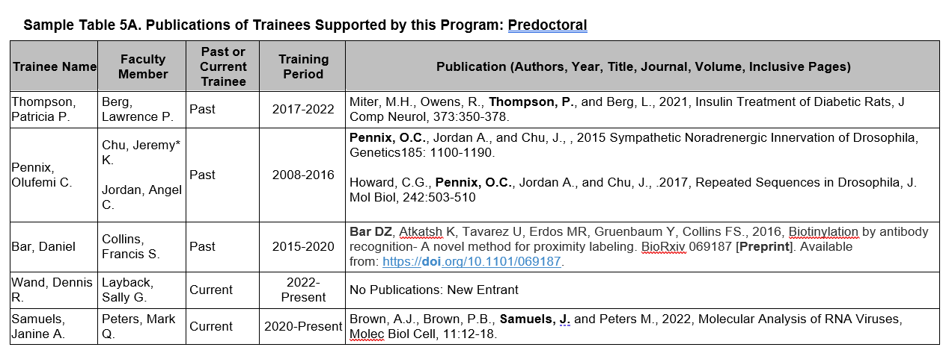
Data Table Updates
Table 5 – Example
List trainees first (followed by PI); trainees will match those listed on Table 8 (up to 10 years)
Add pre-print example
Options
  Add co-mentor
  Can denote former trainers (*)

Slide 17
Data Table Updates
Table 6 - Applicants, Entrants, and their Characteristics for the Past Five Years
Currently, T32 applicants collect detailed trainee characteristics on anyone who applied to and entered the training program.
  Predoc: Mean months of prior research experience, prior institution, and GPA.
  Postdoc: Mean number of publications (total and first author), prior institutions.
Counters NOFO instructions for “multifactorial” candidate review process.
Program admissions is the applicant’s responsibility – NIH wants to focus on post-appointment outcomes.
Planned update: Remove above referenced trainee characteristics.

Slide 18
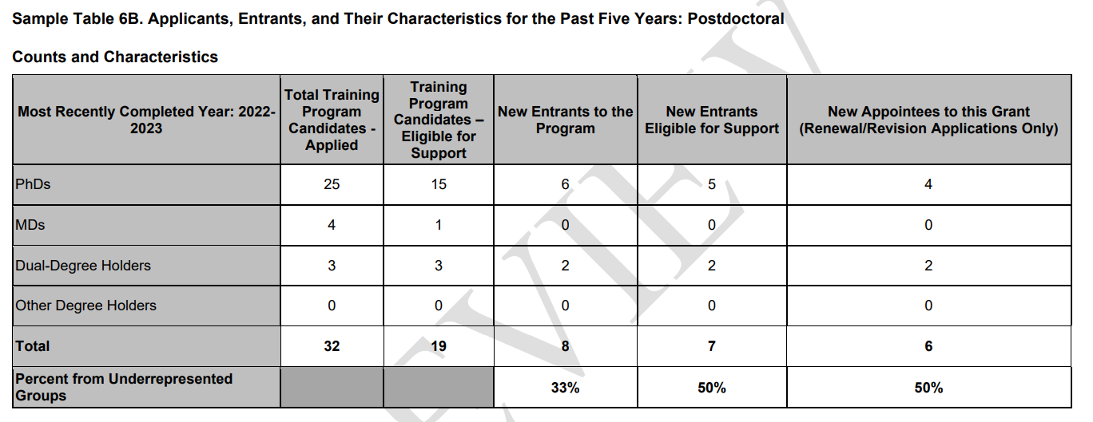

Slide 19
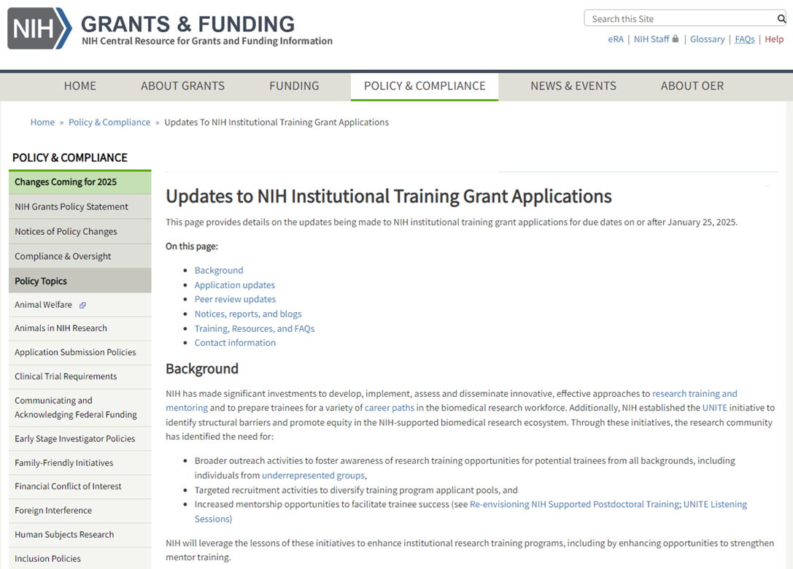
NIH Grants Page on Updates to Institutional Training Grant Applications
Background
Overview of changes
Notices, reports, and blogs
Training, resources, and FAQs
Contact information
Link: grants.nih.gov/policy/changes-coming-jan-2025/updates-to-training-grants.htm

Slide 20

Join us for a webinar on June 5, 2024
Additional information is available from the recording of the June 5 information session hosted by NIH:
Recording and transcript available at: grants.nih.gov/learning-center/nih-training-grant-application-updates-webinar

Slide 21
Data Table Resources at UW-Madison
Table 1
  Provide data from Departments that have updated us in the last 6 months
  Work with applicants to reach to contact Departments for additional data
  Postdoctoral programs?
Table 2
  OTGS are in the process of building a database to generate this report
  Presently we have templates to help work with trainers to request the data
Table 3
  OTGS generates this table based upon T32 directory
Table 4
  OTGS can provide a list of all NIH funding to applicants
Table 6
  OTGS can provide predoctoral level data only
  OTGS will share current data we have collected and work with applicants to facilitate gaps
Notes:
OTGS can also provide demographic data and Information on who completed Research mentor Training

Slide 22
Upcoming Changes to T32 Applications
More information available: https://grants.nih.gov/policy-and-compliance/changes-coming-2025/updates-to-training-grants
Required use of SciENCV for May 2025 submission for all biosketches
Revisions to the NIH Fellowship Application Process
  https://grants.nih.gov/news-events/calendar-of-events/66df170300a3194d910ee602

Slide 23
Future Initiatives from OTGS
Create more transparency in services
Update F workshop to incorporate participant feedback
  As well as changes to Forms-I for fellowship applications
Template for Letter of Institutional Support
Training on biosketches for SciENCV requirement in May
Post award training seminar for administrators
Updates to website and development of KnowledgeBase
Continued efforts for centralized data collections to support data tables
Survey to TG administrators to better understand the environment on campus

